Slide 1
拥抱方舟开源编译器：
Maple IR 分析及 Toy Runtime 介绍
史宁宁
中科院软件所智能软件研究中心程序语言与编译技术实验室

Slide 2
1
方舟编译器概况
2
MAPLE IR的设计与实现
目 录
3
MIR与其他IR的横向对比
4
Phase体系的设计与实现
5
Toy Runtime简介

Slide 3
方舟编译器概况

Slide 4
方舟编译器概述
方舟编译器是为支持多种编程语言、多种芯片平台的联合编译、运行而设计的统一编程平台，包含编译器、工具链、运行时等关键部件。 方舟编译器还在持续演进中，陆续将上述能力实现和开源。
From : https://www.openarkcompiler.cn/home
Notes:
From: https://www.openarkcompiler.cn/home

Slide 5
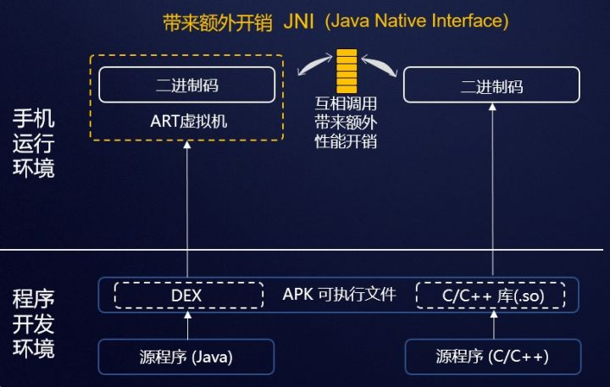
APP开发及运行过程
From: https://zhuanlan.zhihu.com/p/77108133
Notes:
From: https://zhuanlan.zhihu.com/p/77108133

Slide 6
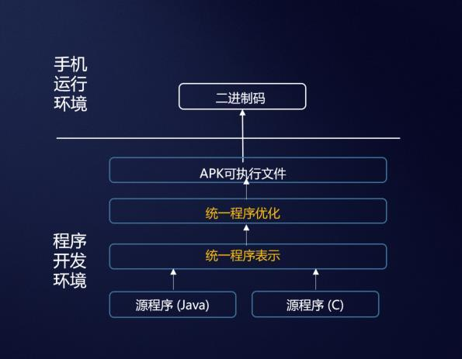
APP开发及运行过程
From: https://zhuanlan.zhihu.com/p/77108133
Notes:
From: https://zhuanlan.zhihu.com/p/77108133

Slide 7
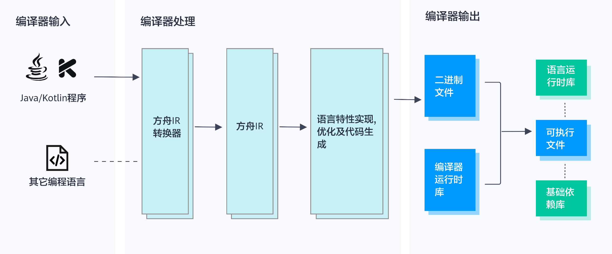
方舟编译器架构示意图
From: https://www.openarkcompiler.cn/document/frameworkDesgin

Slide 8
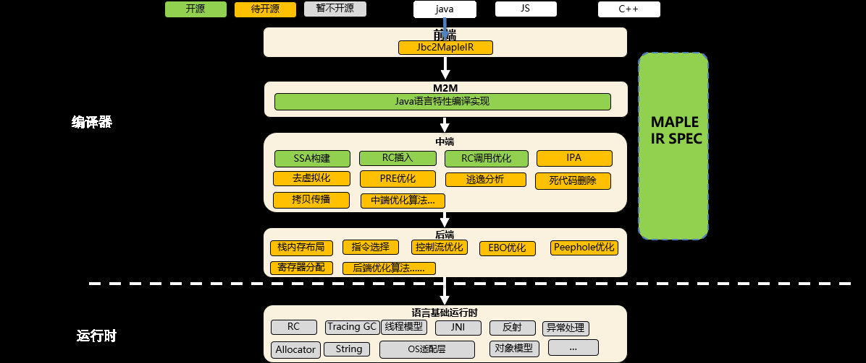
方舟编译器8月开源状况
From: 赵俊民《方舟基础架构与IR中间表示详细介绍》

Slide 9
方舟编译器开源后续计划（2020）
开源
java
JS
C++
前端
Jbc2MapleIR
编译器
M2M
Java语言特性编译实现
MAPLE
IR SPEC
中端
SSA构建
RC插入
RC调用优化
IPA
去虚拟化
PRE优化
逃逸分析
拷贝传播
其他……
后端
栈内存布局
指令选择
控制流优化
EBO优化
Peephole优化
寄存器分配
其他……
语言基础运行时
运行时
RC
Tracing GC
线程模型
JNI
反射
异常处理
Allocator
String
OS适配层
对象模型
…
From: 赵俊民《方舟基础架构与IR中间表示详细介绍》

Slide 10
MAPLE IR的设计与实现

Slide 11
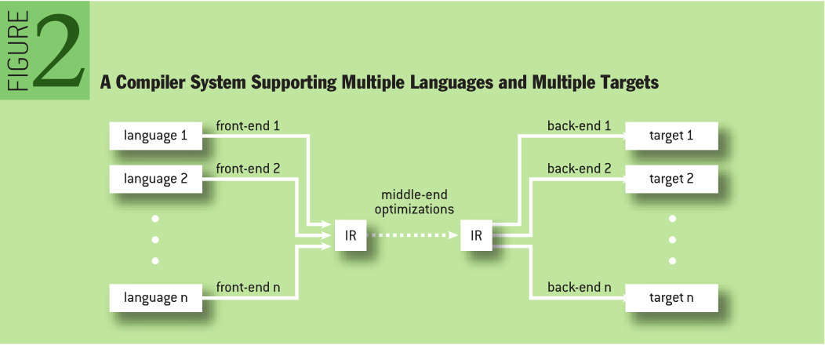
MAPLE IR的设计起源
From: Fred Chow 《The increasing significance of intermediate representations in compilers》

Slide 12
MAPLE IR在方舟编译器中的位置
From: https://www.openarkcompiler.cn/document/frameworkDesgin

Slide 13
方舟编译器的多层IR设计
MAPLE IR‘s program representation at the highest level exhibits the following characteristics : many language constructs, short code sequences, constructs are hierarchical and no loss of program information.
At the lower levels, general purpose optimizations are performed. In particular, at the lowest level, MAPLE IR instructions map one-to-one to machine instructions most of the time, for the mainstream processor ISAs.
From: https://gitee.com/harmonyos/OpenArkCompiler/blob/master/doc/en/MapleIRDesign.md

Slide 14
方舟编译器的多层IR设计
MAPLE IR represents program code intrinsically in the form of trees. At the highest level, it honors the hierarchical form of the program as it exists at the source level via the tree representation. It also honors the abstract operations defined by the language. As compilation proceeds, the abstract operations are lowered into general-purpose operations that require longer code sequences. The program structure also becomes more flat, as general-purpose processors work by executing lists of instructions sequentially.
Though MAPLE IR is target-independent at the highest level, the lowering process will make it become target-dependent.
From: https://gitee.com/harmonyos/OpenArkCompiler/blob/master/doc/en/MapleIRDesign.md

Slide 15
方舟编译器的多层IR设计
高层IR更接近于源程序，包含了更多的程序信息；
底层IR更接近于目标平台的机器指令，甚至有的时候和和机器指令是一对一的关系；
高层IR的保留了程序语言的层次结构，和目标机器平台无关；
底层IR更加扁平化，依赖具体的目标平台。

Slide 16
多层IR设计的特点
优点：
可以提供更多的源程序信息；
IR表达上更加地灵活，更加方便优化；
使得优化算法更加地高效；
可以将优化算法的负面影响降到最低。
缺点：
底层IR的优化器将面临更多的可能，增加了特定语义的识别难度。

Slide 17
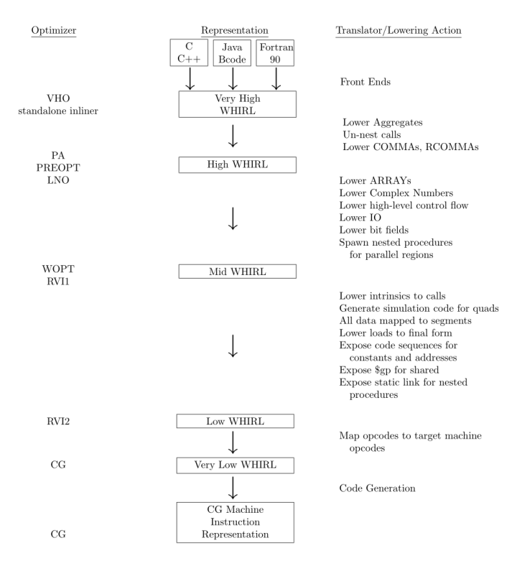

方舟编译器多层IR的分层
Open64多层IR的分层
方舟编译器多层IR的分层
From: 《Open64 Compiler Whirl Intermediate Representation》

Slide 18
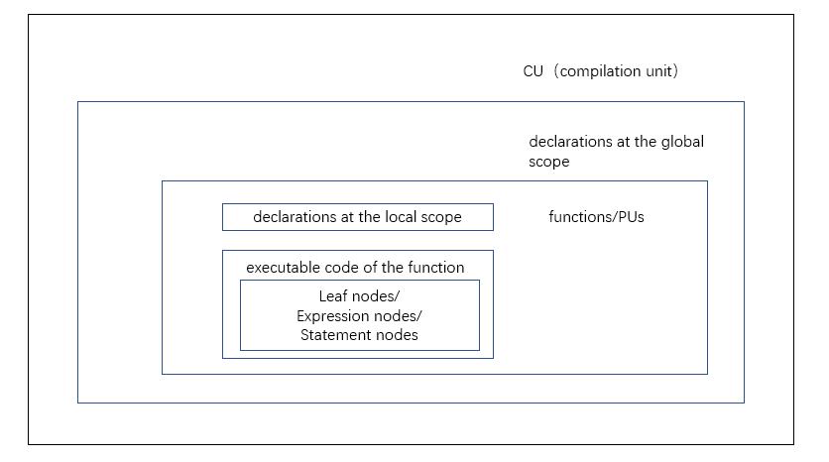
MAPLE IR的结构

Slide 19
语句系统
There are three kinds of executable nodes in MAPLE IR:
Leaf nodes - Also called terminal nodes, these nodes denote a value at execution time, which may be a constant or the value of a storage unit.
Expression nodes - An expression node performs an operation on its operands to compute a result. Its result is a function of the values of its operands and nothing else. Each operand can be either a leaf node or another expression node. Expression nodes are the internal nodes of expression trees. The type field in the expression node gives the type associated with the result of the operation.
Statement nodes - These represent the flow of control. Execution starts at the entry of the function and continues sequentially statement by statement until a control flow statement is executed. Apart from modifying control flow, statements can also modify data storage in the program. A statement nodes has operands that can be leaf, expression or statement.
odes.
From: https://gitee.com/harmonyos/OpenArkCompiler/blob/master/doc/en/MapleIRDesign.md

Slide 20
语句系统
odes.
Statement nodes
Expression nodes
Leaf nodes

Slide 21
基本类型
文档中的基本类型：
no type - void
signed integers - i8, i16, i32, i64
unsigned integers - u8, u16, u32, u64
booleans- u1
addresses - ptr, ref, a32, a64
floating point numbers - f32, f64
complex numbers - c64, c128
javascript types - dynany、dynu32、dyni32、dynundef、dynnull、dynhole、dynbool、dynptr、dynf64、dynf32、dynstr、dynobj
SIMD types - (to be defined)
unknown
From: https://gitee.com/harmonyos/OpenArkCompiler/blob/master/doc/en/MapleIRDesign.md

Slide 22
文档和源码中的基本类型对比
文档
dynu32、
dynhole、dynptr
源码
f128、 simplestr、simpleobj、dynnone、constStr、gen、agg
相同
部分

Slide 23
文档中的控制流语句1
Hierarchical control flow statements：
doloop
dowhile
foreachelem
if
while
From: https://gitee.com/harmonyos/OpenArkCompiler/blob/master/doc/en/MapleIRDesign.md

Slide 24
文档中的控制流语句2
Flat control flow statements：
brfalse
brtrue
multiway
return
switch
goto
rangegoto
indexgoto
From: https://gitee.com/harmonyos/OpenArkCompiler/blob/master/doc/en/MapleIRDesign.md

Slide 25
源码中的控制流语句1
hierarchical control flow opcodes
OPCODE(block, BlockNode, (OPCODEISSTMT | OPCODENOTMMPL), 0)
OPCODE(doloop, DoloopNode, (OPCODEISSTMT | OPCODENOTMMPL), 0)
OPCODE(dowhile, WhileStmtNode, (OPCODEISSTMT | OPCODENOTMMPL), 0)
OPCODE(if, IfStmtNode, (OPCODEISSTMT | OPCODENOTMMPL), 0)
OPCODE(while, WhileStmtNode, (OPCODEISSTMT | OPCODENOTMMPL), 0)
OPCODE(switch, SwitchNode, (OPCODEISSTMT | OPCODENOTMMPL), 8)
OPCODE(multiway, MultiwayNode, (OPCODEISSTMT | OPCODENOTMMPL), 8)
OPCODE(foreachelem, ForeachelemNode, (OPCODEISSTMT | OPCODENOTMMPL), 0)
From: https://gitee.com/harmonyos/OpenArkCompiler/blob/master/src/maple_ir/include/opcodes.def

Slide 26
源码中的控制流语句2
flat control flow opcodes
OPCODE(goto, GotoNode, OPCODEISSTMT, 8)
OPCODE(brfalse, CondGotoNode, OPCODEISSTMT, 8)
OPCODE(brtrue, CondGotoNode, OPCODEISSTMT, 8)
OPCODE(return, NaryStmtNode, (OPCODEISSTMT | OPCODEISVARSIZE |
OPCODEHASSSAUSE), 0)
OPCODE(rangegoto, RangegotoNode, OPCODEISSTMT, 8)
From: https://gitee.com/harmonyos/OpenArkCompiler/blob/master/src/maple_ir/include/opcodes.def

Slide 27
控制流语句对应的节点实现1

Slide 28
控制流语句对应的节点实现2

Slide 29
MIR与其它IR的横向对比

Slide 30
MIR与LLVM IR的基本类型对比
序号 | 方舟编译器类型类别 | 方舟编译器类型 | LLVM类型类别 | LLVM类型类别 | LLVM类型类别 | LLVM类型
1 | no type | void |  |  |  | void
2 | signed integers | i8 | First Class Types | Single Value Types | Integer Type | iN
3 |  | i16
4 |  | i32
5 |  | i64
6 | unsigned integers | u8
7 |  | u16
8 |  | u32
9 |  | u64
10 | booleans | u1
11 | addresses | ptr | First Class Types | Single Value Types | Pointer Type | <type> *
12 |  | ref
13 |  | a32
14 |  | a64

Slide 31
MIR与LLVM IR的基本类型对比（续）
序号 | 方舟编译器类型类别 | 方舟编译器类型 | LLVM类型类别 | LLVM类型类别 | LLVM类型类别 | LLVM类型
15 | floating point numbers | f32 | First Class Types | Single Value Types | Floating-Point Types | half
16 |  | f64 |  |  |  | float
17 | complex numbers | c64 |  |  |  | double
18 |  | c128 |  |  |  | fp128
19 | javascript types | dynany |  |  |  | x86_fp80
20 |  | dynu32 |  |  |  | ppc_fp128
21 |  | dyni32
22 |  | dynundef
23 |  | dynnull
24 |  | dynhole
25 |  | dynbool
26 |  | dynptr
27 |  | dynf64
28 |  | dynf32
29 |  | dynstr
30 |  | dynobj
31 | SIMD types | to be defined
32 |  | unknown

Slide 32
MIR与LLVM IR的基本类型对比（续）
序号 | 方舟编译器类型类别 | 方舟编译器类型 | LLVM类型类别 | LLVM类型类别 | LLVM类型类别 | LLVM类型
33 |  |  |  |  | Function Type | <returntype> (<parameter list>)
34 |  |  | First Class Types | Single Value Types | X86_mmx Type | x86_mmx
35 |  |  |  |  | Vector Type | < <# elements> x <elementtype> > ; Fixed-length vector < vscale x <# elements> x <elementtype> > ; Scalable vector
36 |  |  |  | Label Type |  | label
37 |  |  |  | Token Type |  | token
38 |  |  |  | Metadata Type |  | metadata
39 |  |  |  | Aggregate Types | Array Type | [<# elements> x <elementtype>]
40 |  |  |  |  | Structure Type | %T1 = type { <type list> } ; Identified normal struct type %T2 = type <{ <type list> }> ; Identified packed struct type
41 |  |  |  |  | Opaque Structure Types | %X = type opaque %52 = type opaque

Slide 33
MIR与LLVM IR的基本类型对比（续）
总结：
MAPLE IR和LLVM IR的基本类型设计思想不同，所以二者的基本类型采用的是不同的风格，基本没有相同的类型表示。

Slide 34
MIR与WHIRL IR的基本类型对比
序号 | MAPLE IR基本类型类别 | MAPLE IR基本类型 | WHIRL IR 基本类型
1 | no type | void | V
2 | signed integers | i8 | I1
3 |  | i16 | I2
4 |  | i32 | I4
5 |  | i64 | I8
6 | unsigned integers | u8 | U1
7 |  | u16 | U2
8 |  | u32 | U3
9 |  | u64 | U4
10 | booleans | u1 | B
11 | addresses | ptr
12 |  | ref
13 |  | a32 | A4
14 |  | a64 | A8

Slide 35
序号 | MAPLE IR基本类型类别 | MAPLE IR基本类型 | WHIRL IR 基本类型
15 | floating point numbers | f32 | F4
16 |  | f64 | F8
17 |  |  | F10
18 |  |  | F16
19 |  |  | FQ
20 | complex numbers |  | C4
21 |  | c64 | C8
22 |  | c128 | CQ
23 | javascript types | dynany
24 |  | dynu32
25 |  | dyni32
26 |  | dynundef
27 |  | dynnull
28 |  | dynhole
29 |  | dynbool
30 |  | dynptr
31 |  | dynf64
32 |  | dynf32
33 |  | dynstr
34 |  | dynobj
MIR与WHIRL IR的基本类型对比（续）

Slide 36
MIR与WHIRL IR的基本类型对比（续）
序号 | MAPLE IR基本类型类别 | MAPLE IR基本类型 | WHIRL IR 基本类型
35 | SIMD types | to be defined
36 |  | unknown
37 |  |  | M
38 |  |  | BS
总结：除去javascript的专用基本类型，二者有16/26种基本类型设计一致。

Slide 37
MIR与WHIRL IR的控制流语句对比
序号 | MAPLE IR | WHIRL IR
1 | doloop | DOLOOP
2 | dowhile | DOWHILE
3 | foreachelem
4 | if | IF
5 | while | WHILEDO
6 |  | FUNCENTRY
7 |  | BLOCK
8 |  | REGION

Slide 38
序号 | MAPLE IR | WHIRL IR
9 | brfalse | FALSEBR
10 | brtrue | TRUEBR
11 | multiway
12 | return | RETURN
13 |  | RETURN_VAL
14 | switch | SWITCH
15 | goto | GOTO
16 | rangegoto
17 | indexgoto
18 |  | GOTO_OUTER_BLOCK
19 |  | CASEGOTO
20 |  | COMPGOTO
21 |  | XGOTO
22 |  | AGOTO
23 |  | REGION_EXIT
24 |  | ALTENTRY
25 |  | LABEL
26 |  | LOOP_INFO
MIR与WHIRL IR的控制流语句对比（续）
总结：除了个别控制流语句之外，MAPLE IR基本上是WHIRL IR的一个子集。

Slide 39
Phase体系的设计与实现

Slide 40
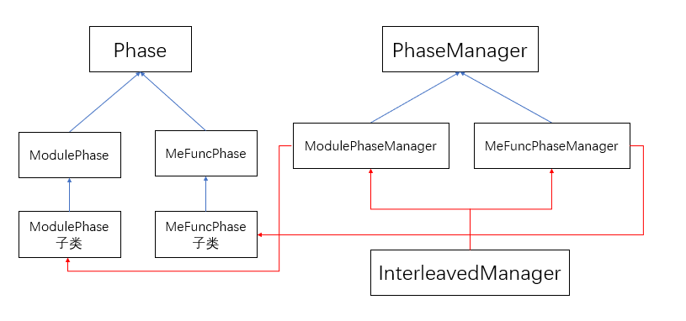
Phase体系的设计与实现

Slide 41
Phase列表（phases.def）
ADD_PHASE("classhierarchy", true)
ADD_PHASE("vtableanalysis", true)
ADD_PHASE("reflectionanalysis", true)
ADD_PHASE("gencheckcast", true)
ADD_PHASE("javaintrnlowering", true)
// mephase begin
ADD_PHASE("ssatab", true)
ADD_PHASE("aliasclass", true)
ADD_PHASE("ssa", true)
ADD_PHASE("analyzerc", true)
ADD_PHASE("rclowering", true)
ADD_PHASE("emit", true)
// mephase end
ADD_PHASE("GenNativeStubFunc", true)
ADD_PHASE("clinit", true)
ADD_PHASE("VtableImpl", true)
ADD_PHASE("javaehlower", true)
ADD_PHASE("MUIDReplacement", true)
From: https://gitee.com/harmonyos/OpenArkCompiler/blob/master/src/maple_driver/defs/phases.def

Slide 42
ModulePhase类的phase
父类 | 子类 | 源码位置 | phase名称
ModulePhase | DoCheckCastGeneration | src/mpl2mpl/include/gen_check_cast.h | gencheckcast
 | DoClassInit | src/mpl2mpl/include/class_init.h | clinit
 | DoGenericNativeStubFunc | src/mpl2mpl/include/native_stub_func.h | GenNativeStubFunc
 | DoJavaIntrnLowering | src/mpl2mpl/include/java_intrn_lowering.h | javaintrnlowering
 | DoKlassHierarchy | src/maple_ipa/include/module_phase_manager.h | classhierarchy
 | DoMUIDReplacement | src/mpl2mpl/include/muid_replacement.h | MUIDReplacement
 | DoReflectionAnalysis | src/mpl2mpl/include/reflection_analysis.h | reflectionanalysis
 | DoVtableAnalysis | src/mpl2mpl/include/vtable_analysis.h | vtableanalysis
 | DoVtableImpl | src/mpl2mpl/include/vtable_impl.h | VtableImpl
 | JavaEHLowererPhase | src/maple_ir/include/java_eh_lower.h | javaehlower

Slide 43
MeFuncPhase类的phase
父类 | 子类 | 源码位置 | phase名称
MeFuncPhase | MeDoAliasClass | src/maple_me/include/me_alias_class.h | aliasclass
 | MeDoBBLayout | src/maple_me/include/me_bb_layout.h | bblayout
 | MeDoDominance | src/maple_me/include/me_dominance.h | dominance
 | MeDoEmission | src/maple_me/include/me_emit.h | emit
 | MeDoIRMap | src/maple_me/include/me_irmap.h | irmap
 | MeDoRCLowering | src/maple_me/include/me_rc_lowering.h | rclowering
 | MeDoSSA | src/maple_me/include/me_ssa.h | ssa
 | MeDoSSATab | src/maple_me/include/me_ssa_tab.h | ssaTab

Slide 44
Toy Runtime简介

Slide 45
Toy Runtime简介
Toy Runtime是中科院软件所智能软件中心程序语言与编译技术实验室在开发的一个方舟编译器Runtime参考实现，这个项目是为了实现一个示例Runtime版本。
Toy Runtime开源地址：https://github.com/isrc-cas/pacific

Slide 46
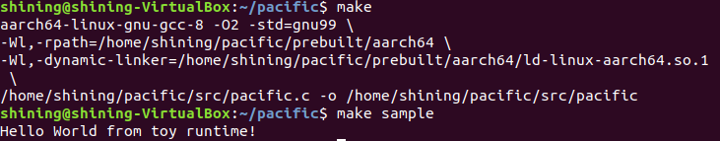
Toy Runtime简介
目前Toy Runtime已经发布了V0.1版本。
在没有方舟运行时环境设计细节的前提下，我们进行了一定程度的hack和逆向。 采用QEMU来提供AArch64的架构支持，把方舟的Java的那一套巧妙地（硬生生）用GNU/Linux的方式「fake」 了一套可以跑「Hello World」的 Toy Runtime 。

